Slide 1
OpenGL – WebGL
Programming with WebGL
and Shaders
Este curso utiliza material adaptado procedente del curso:
Angel and Shreiner: Interactive Computer Graphics 7E © Addison-Wesley 2015

Slide 2
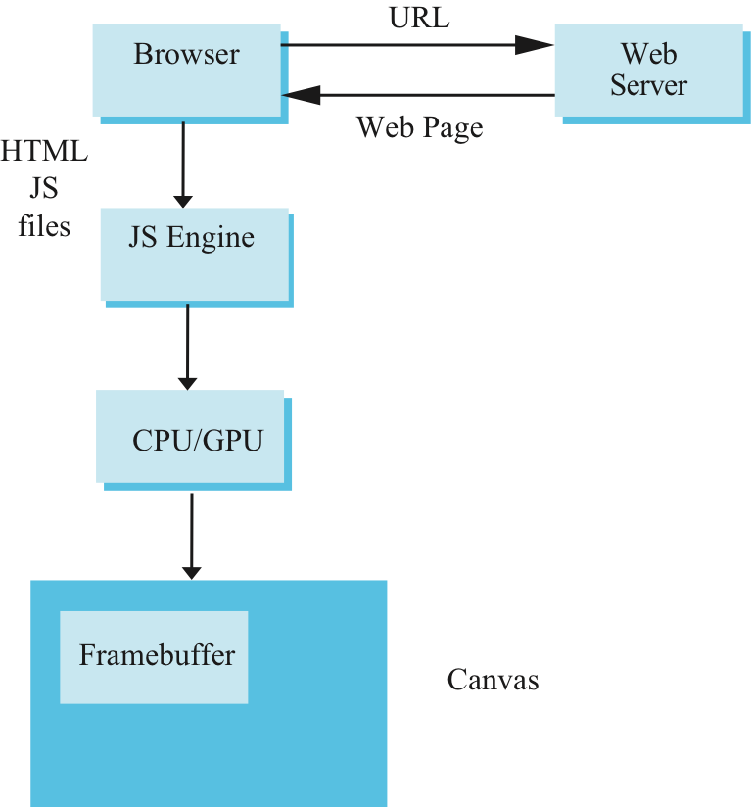
Execution in a Browser
Angel and Shreiner: Interactive Computer Graphics 7E © Addison-Wesley 2015

Slide 3
STEPS
Create a Canvas
Create a WebGL Context
Define and compile Shaders
Load data into WebGL
Draw primitives

Slide 4
Create a Canvas

Slide 5
Create a Canvas
<!doctype html>
<html>
<head>
<title>A blank canvas</title>
<style>
body {
background-color: grey;
}
canvas {
background-color: white;
}
</style>
</head>
<body>
<canvas id="my-canvas" width="600" height="600">
Your browser does not support the HTML5 canvas element.
</canvas>
</body>
</html>

Slide 6
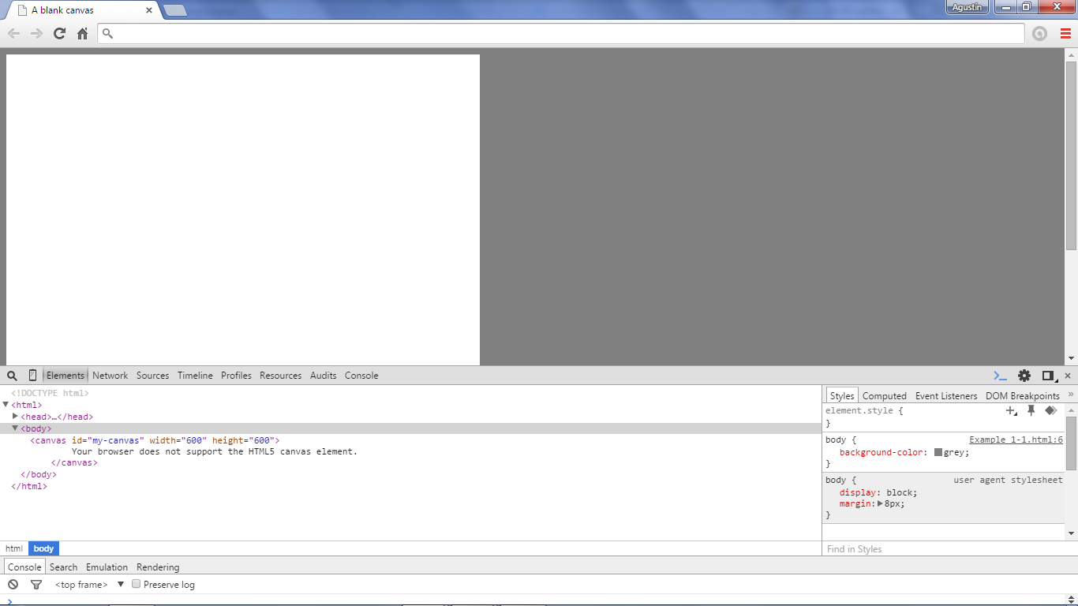
Example 1-1.html

Slide 7
Create a Context

Slide 8
Create a Context
<script>
window.onload = setupWebGL;
var gl = null;
function setupWebGL()
{
var canvas = document.getElementById("my-canvas");
try{
gl = canvas.getContext("experimental-webgl");
}catch(e){
}
if(gl)
{
//set the clear color to red
gl.clearColor(1.0, 0.0, 0.0, 1.0);
gl.clear(gl.COLOR_BUFFER_BIT);
}else{
alert( "Error: Your browser does not appear to support WebGL.");
}
}
</script>

Slide 9
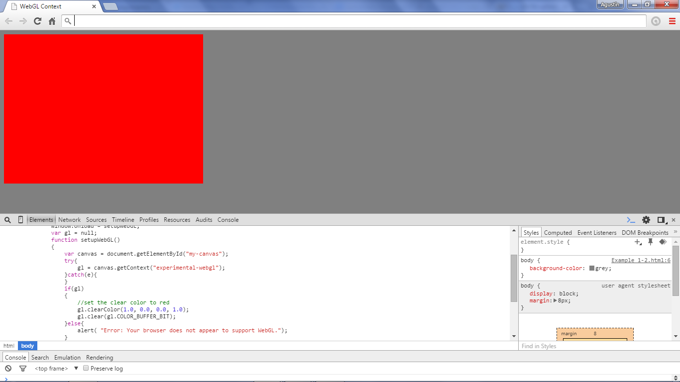
Example 1-2.html

Slide 10
Define &Compile Shaders

Slide 11
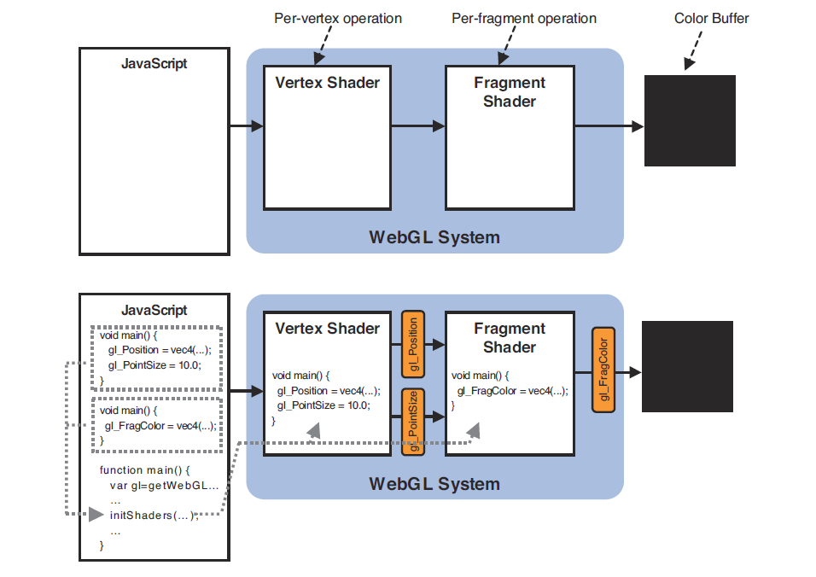

Slide 12
Linking Shaders with Application
Read shaders
Compile shaders
Create a program object
Link everything together
Link variables in application with variables in shaders
  Vertex attributes
  Uniform variables
Angel and Shreiner: Interactive Computer Graphics 7E © Addison-Wesley 2015

Slide 13
Reading a Shader
Shaders are added to the program object and compiled
Usual method of passing a shader is as a null-terminated string using the function
gl.shaderSource( fragShdr, fragElem.text );
If shader is in HTML file, we can get it into application by getElementById method
If the shader is in a file, we can write a reader to convert the file to a string
Angel and Shreiner: Interactive Computer Graphics 7E © Addison-Wesley 2015

Slide 14
Adding a Vertex Shader
var vertShdr;
var vertElem =
document.getElementById( vertexShaderId );
vertShdr = gl.createShader( gl.VERTEX_SHADER );
gl.shaderSource( vertShdr, vertElem.text );
gl.compileShader( vertShdr );
// after program object created
gl.attachShader( program, vertShdr );
Angel and Shreiner: Interactive Computer Graphics 7E © Addison-Wesley 2015

Slide 15
Shader Reader
Following code may be a security issue with some browsers if you try to run it locally
  Cross Origin Request
function getShader(gl, shaderName, type) {
var shader = gl.createShader(type);
shaderScript = loadFileAJAX(shaderName);
if (!shaderScript) {
alert("Could not find shader source:
"+shaderName);
}
}
Angel and Shreiner: Interactive Computer Graphics 7E © Addison-Wesley 2015

Slide 16
Define Shaders
(Example 1-3.html)
<script id="shader-vs" type="x-shader/x-vertex">
attribute vec3 aVertexPosition;
void main(void) {
gl_Position = vec4(aVertexPosition, 1.0);
}
</script>
<script id="shader-fs" type="x-shader/x-fragment">
void main(void) {
gl_FragColor = vec4(1.0, 1.0, 1.0, 1.0);
}
</script>

Slide 17
Compile Shaders (I)
function initShaders() {
//get shader source
var fs_source = document.getElementById('shader-fs').html(),
vs_source = document.getElementById('shader-vs').html();
...
}

Slide 18
Compile Shaders (II)
function initShaders() {
...
//compile shaders
vertexShader = makeShader(vs_source, gl.VERTEX_SHADER);
fragmentShader = makeShader(fs_source, gl.FRAGMENT_SHADER);
...
}

Slide 19
Compile Shaders (II)
function makeShader(src, type) {
//compile the vertex shader
var shader = gl.createShader(type);
gl.shaderSource(shader, src);
gl.compileShader(shader);
if (!gl.getShaderParameter(shader, gl.COMPILE_STATUS)) {
alert("Error compiling shader: " +
gl.getShaderInfoLog(shader));
}
return shader;
}

Slide 20
Program Object
Container for shaders
  Can contain multiple shaders
  Other GLSL functions
var program = gl.createProgram();
gl.attachShader( program, vertShdr ); gl.attachShader( program, fragShdr ); gl.linkProgram( program );
Angel and Shreiner: Interactive Computer Graphics 7E © Addison-Wesley 2015

Slide 21
Compile Shaders (III)
function initShaders() {
...
//create program
glProgram = gl.createProgram();
//attach and link shaders to the program
gl.attachShader(glProgram, vertexShader);
gl.attachShader(glProgram, fragmentShader);
…
}

Slide 22
Compile Shaders (IV)
function initShaders() {
...
gl.linkProgram(glProgram);
if (!gl.getProgramParameter(glProgram, gl.LINK_STATUS)) {
alert("Unable to initialize the shader program.");
}
//use program
gl.useProgram(glProgram);
}

Slide 23
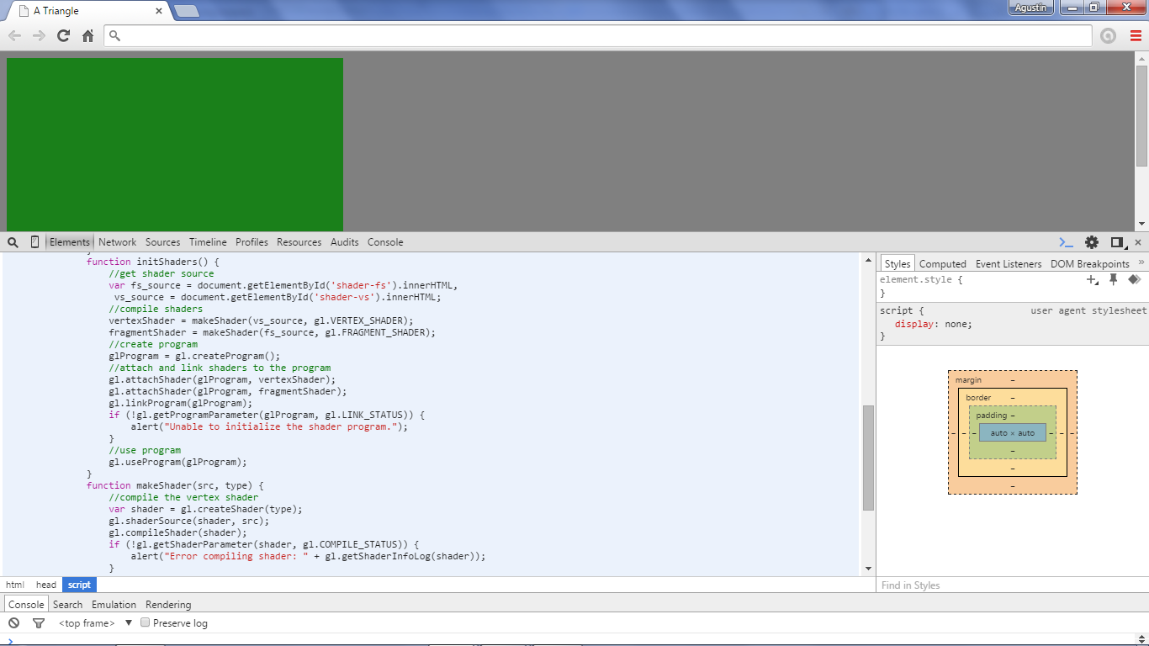
Example 1-4.html

Slide 24
Load Data

Slide 25
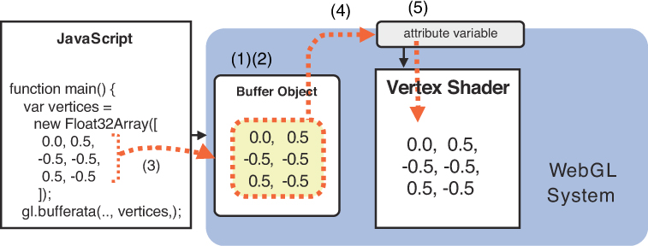

Slide 26
Load Data
var triangleVertices = [
//left triangle
-0.5, 0.5, 0.0,
0.0, 0.0, 0.0,
-0.5, -0.5, 0.0,
//right triangle
...
];
trianglesVerticeBuffer = gl.createBuffer();
gl.bindBuffer(gl.ARRAY_BUFFER, trianglesVerticeBuffer);
gl.bufferData(gl.ARRAY_BUFFER, new
Float32Array(triangleVertices), gl.STATIC_DRAW);

Slide 27
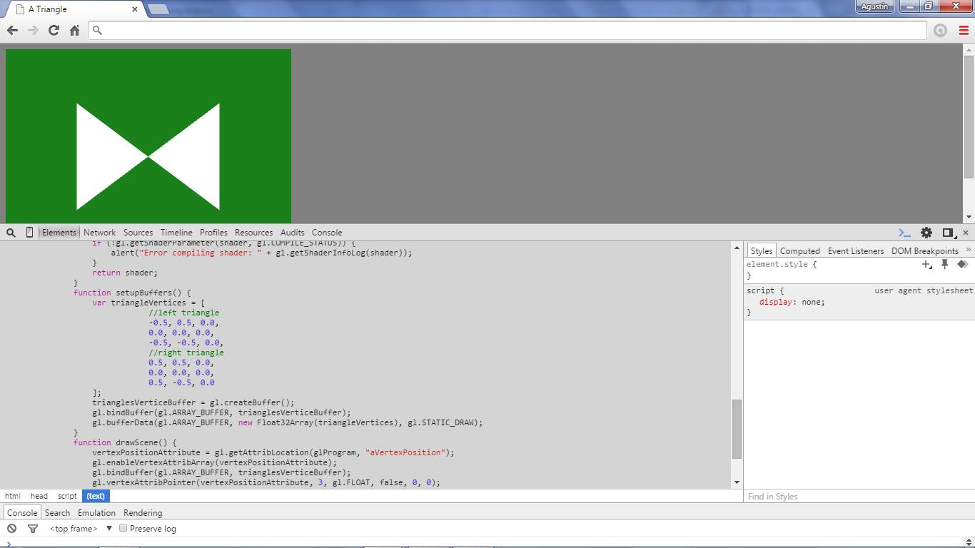
Example 1-5.html

Slide 28
Draw

Slide 29
Draw
vertexPositionAttribute = gl.getAttribLocation(glProgram, "aVertexPosition");
gl.enableVertexAttribArray(vertexPositionAttribute);
gl.bindBuffer(gl.ARRAY_BUFFER, trianglesVerticeBuffer);
gl.vertexAttribPointer(vertexPositionAttribute, 3, gl.FLOAT, false, 0, 0);
gl.drawArrays(gl.TRIANGLES, 0, 6);

Slide 30
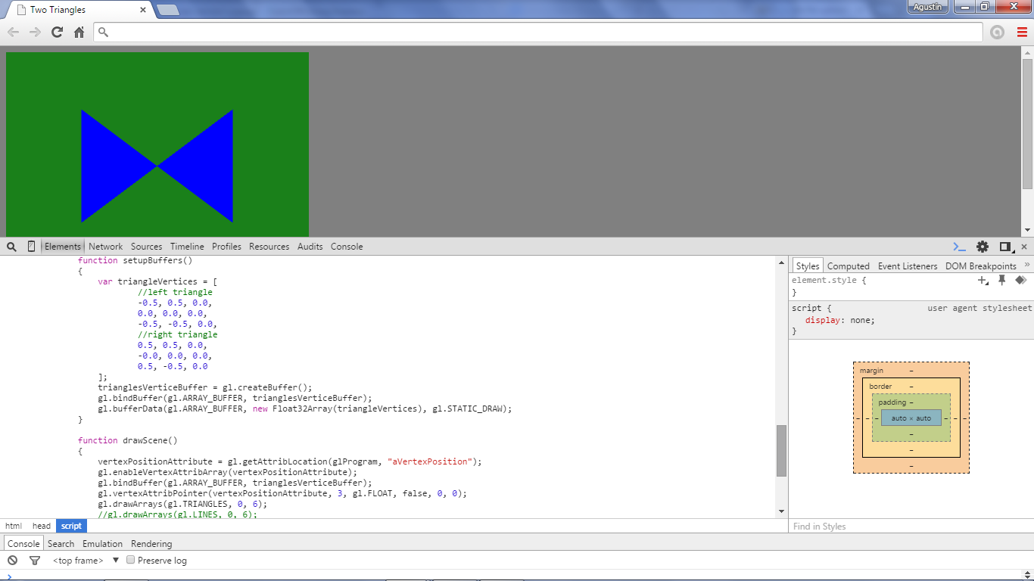
Example 1-6 Two triangles.html

Slide 31
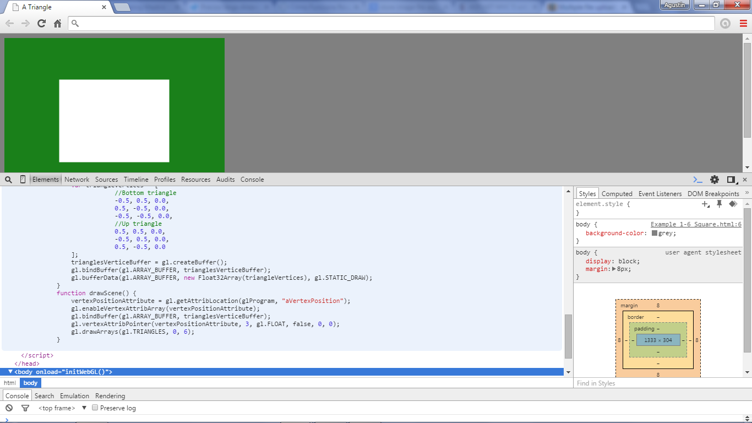
Example 1-6 Square.html

Slide 32
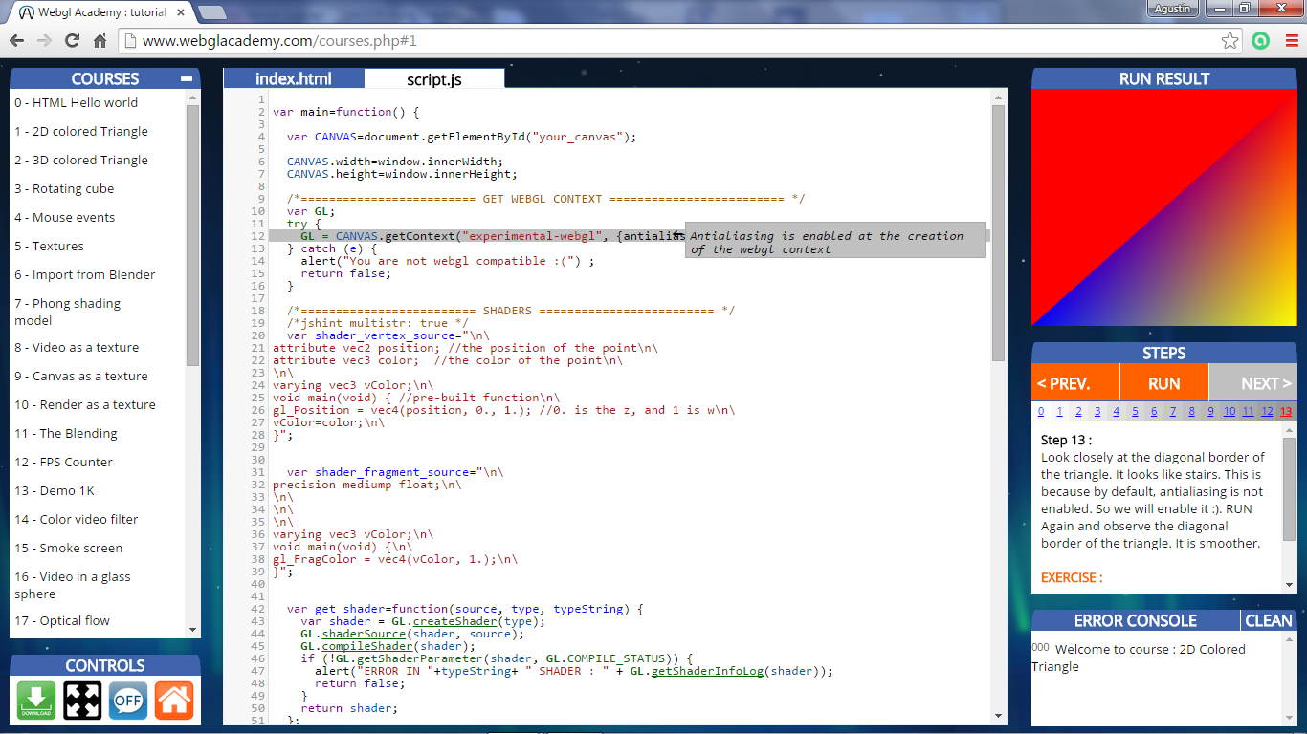
http://www.webglacademy.com/courses.php#0

Slide 33
Shaders

Slide 34
Writing Shaders
First programmable shaders were programmed in an assembly-like manner
OpenGL extensions added functions for vertex and fragment shaders
Cg (C for graphics) C-like language for programming shaders
  Works with both OpenGL and DirectX
  Interface to OpenGL complex
OpenGL Shading Language (GLSL)
Angel and Shreiner: Interactive Computer Graphics 7E © Addison-Wesley 2015

Slide 35
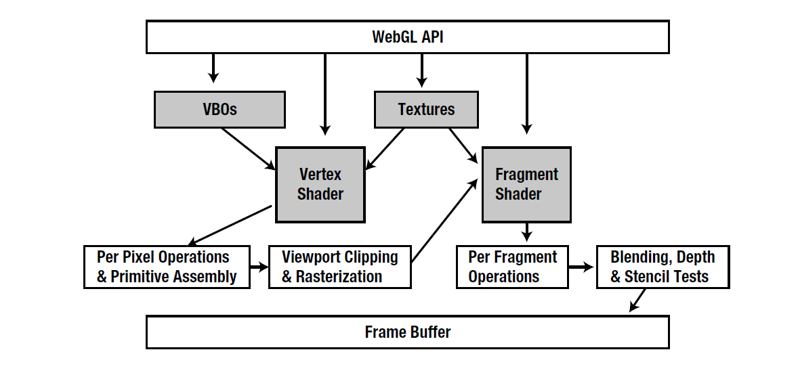

Slide 36
GLSL
OpenGL Shading Language
Part of OpenGL 2.0 and up
High level C-like language
New data types
  Matrices
  Vectors
  Samplers
As of OpenGL 3.1, application must provide shaders
Angel and Shreiner: Interactive Computer Graphics 7E © Addison-Wesley 2015

Slide 37
Shaders Examples

Slide 38



Simple Vertex Shader
attribute vec4 vPosition;
void main(void)
{
gl_Position = vPosition;
}
Angel and Shreiner: Interactive Computer Graphics 7E © Addison-Wesley 2015

Slide 39
Execution Model
Vertex data
Shader Program
GPU
Application
Program
Vertex
Shader
Primitive
Assembly
gl.drawArrays
Vertex
Angel and Shreiner: Interactive Computer Graphics 7E © Addison-Wesley 2015

Slide 40
Simple Fragment Program
precision mediump float;
void main(void)
{
gl_FragColor = vec4(1.0, 0.0, 0.0, 1.0);
}
Angel and Shreiner: Interactive Computer Graphics 7E © Addison-Wesley 2015

Slide 41
Execution Model
Application
Shader Program
Rasterizer
Fragment
Shader
Frame Buffer
Fragment
Fragment
Color
Angel and Shreiner: Interactive Computer Graphics 7E © Addison-Wesley 2015

Slide 42
Data Types
C types: int, float, bool
Vectors:
  float vec2, vec3, vec4
  Also int (ivec) and boolean (bvec)
Matrices: mat2, mat3, mat4
  Stored by columns
  Standard referencing m[row][column]
C++ style constructors
  vec3 a =vec3(1.0, 2.0, 3.0)
  vec2 b = vec2(a)
Angel and Shreiner: Interactive Computer Graphics 7E © Addison-Wesley 2015

Slide 43
No Pointers
There are no pointers in GLSL
We can use C structs which can be copied back from functions
Because matrices and vectors are basic types they can be passed into and output from GLSL functions, e.g.
mat3 func(mat3 a)
Variables passed by copying
Angel and Shreiner: Interactive Computer Graphics 7E © Addison-Wesley 2015

Slide 44
Swizzling and Selection
Can refer to array elements by element using [] or selection (.) operator with
  x, y, z, w
  r, g, b, a
  s, t, p, q
  a[2], a.b, a.z, a.p are the same
Swizzling operator lets us manipulate components
  vec4 a, b;
  a.yz = vec2(1.0, 2.0, 3.0, 4.0);
  b = a.yxzw;
Angel and Shreiner: Interactive Computer Graphics 7E © Addison-Wesley 2015

Slide 45
Operators and Functions
Standard C functions
  Trigonometric
  Arithmetic
  Normalize, reflect, length
Overloading of vector and matrix types
  mat4 a;
  vec4 b, c, d;
  c = b*a; // a column vector stored as a 1d array
  d = a*b; // a row vector stored as a 1d array
Angel and Shreiner: Interactive Computer Graphics 7E © Addison-Wesley 2015

Slide 46
Qualifiers
GLSL has many of the same qualifiers such as const as C/C++
Need others due to the nature of the execution model
Variables can change
  Once per primitive
  Once per vertex
  Once per fragment
  At any time in the application
Vertex attributes are interpolated by the rasterizer into fragment attributes
Angel and Shreiner: Interactive Computer Graphics 7E © Addison-Wesley 2015

Slide 47
Attribute Qualifier
Attribute-qualified variables can change at most once per vertex
There are a few built in variables such as gl_Position but most have been deprecated
User defined (in application program)
  attribute float temperature
  attribute vec3 velocity
  recent versions of GLSL use in and out qualifiers to get to and from shaders
Angel and Shreiner: Interactive Computer Graphics 7E © Addison-Wesley 2015

Slide 48
Uniform Qualified
Variables that are constant for an entire primitive
Can be changed in application and sent to shaders
Cannot be changed in shader
Used to pass information to shader such as the time or a bounding box of a primitive or transformation matrices
Angel and Shreiner: Interactive Computer Graphics 7E © Addison-Wesley 2015

Slide 49
Varying Qualified
Variables that are passed from vertex shader to fragment shader
Automatically interpolated by the rasterizer
With WebGL, GLSL uses the varying qualifier in both shaders
  varying vec4 color;
More recent versions of WebGL use out in vertex shader and in in the fragment shader
  out vec4 color; //vertex shader
  in vec4 color; // fragment shader
Angel and Shreiner: Interactive Computer Graphics 7E © Addison-Wesley 2015

Slide 50
Our Naming Convention
attributes passed to vertex shader have names beginning with v (v Position, vColor) in both the application and the shader
  Note that these are different entities with the same name
Variable variables begin with f (fColor) in both shaders
  must have same name
Uniform variables are unadorned and can have the same name in application and shaders
Angel and Shreiner: Interactive Computer Graphics 7E © Addison-Wesley 2015

Slide 51
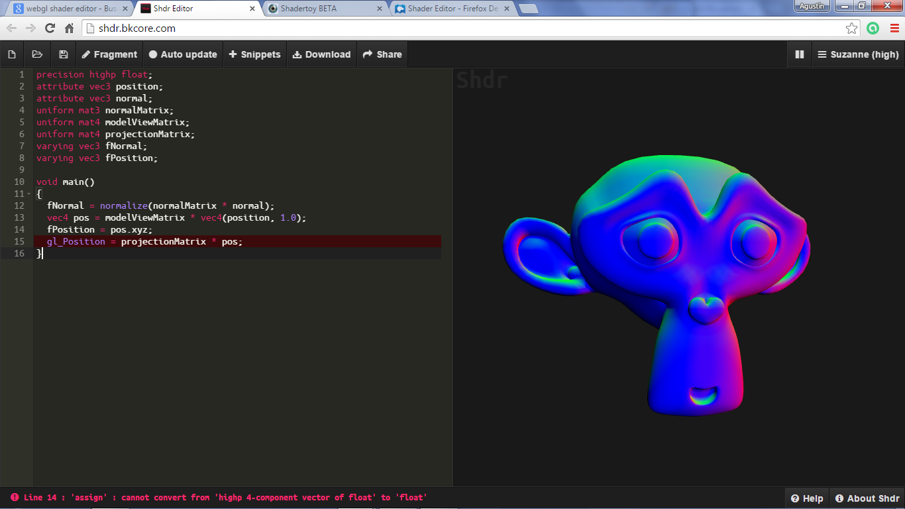
http://shdr.bkcore.com/

Slide 52
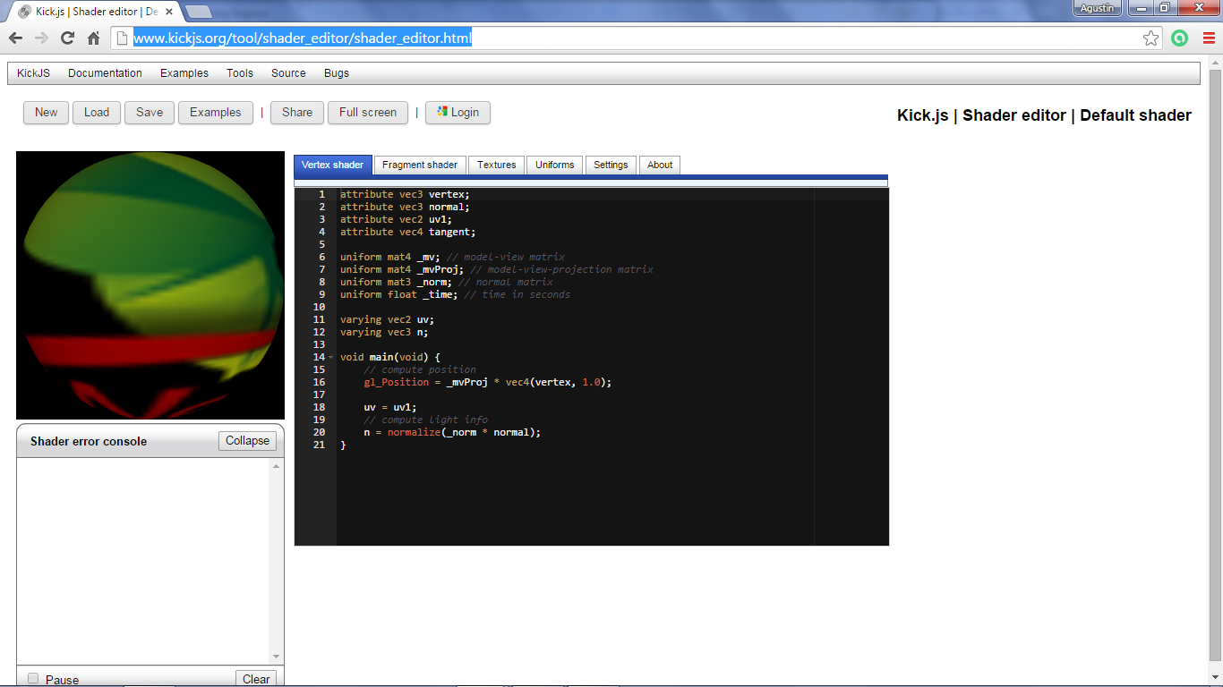
http://www.kickjs.org/tool/shader_editor/shader_editor.html

Slide 53
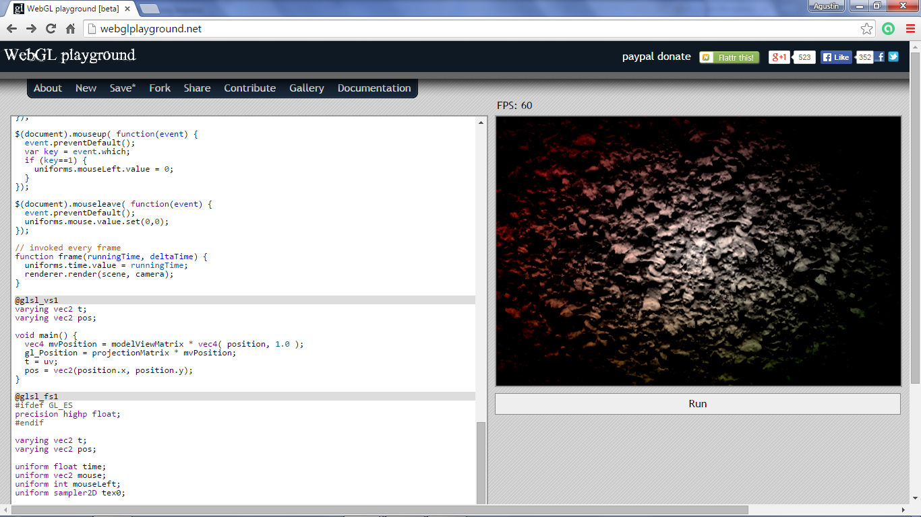
http://webglplayground.net/

Slide 54
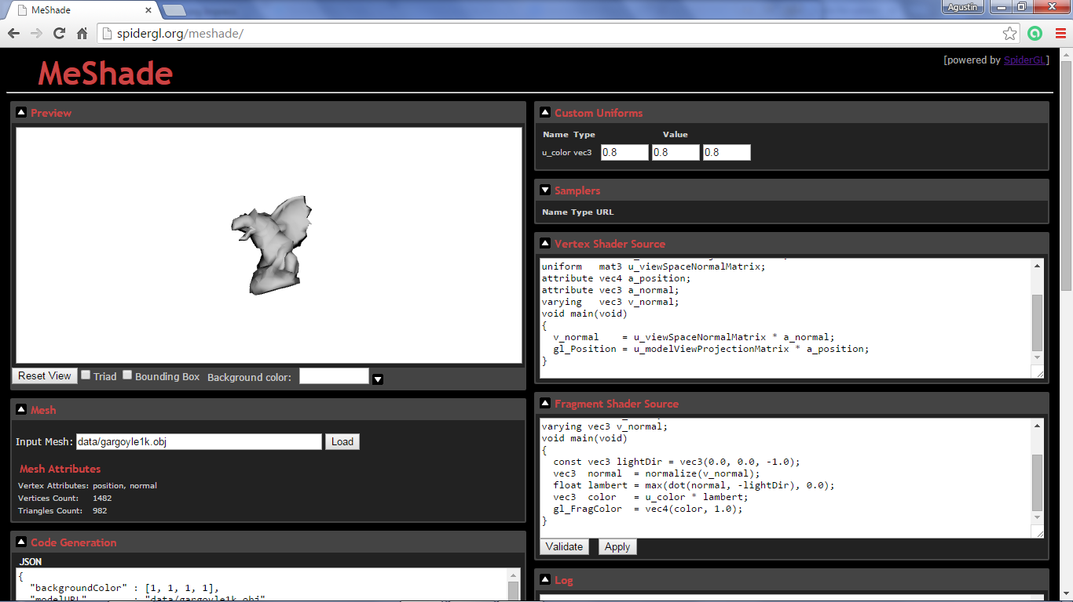
http://spidergl.org/meshade/

Slide 55
Objectives
Expanding primitive set
Adding color
Vertex attributes
Angel and Shreiner: Interactive Computer Graphics 7E © Addison-Wesley 2015

Slide 56
Attributes
Attributes determine the appearance of objects
  Color (points, lines, polygons)
  Size and width (points, lines)
  Stipple pattern (lines, polygons)
  Polygon mode
    Display as filled: solid color or stipple pattern
    Display edges
    Display vertices
Only a few (gl_PointSize) are supported by WebGL functions
Angel and Shreiner: Interactive Computer Graphics 7E © Addison-Wesley 2015

Slide 57
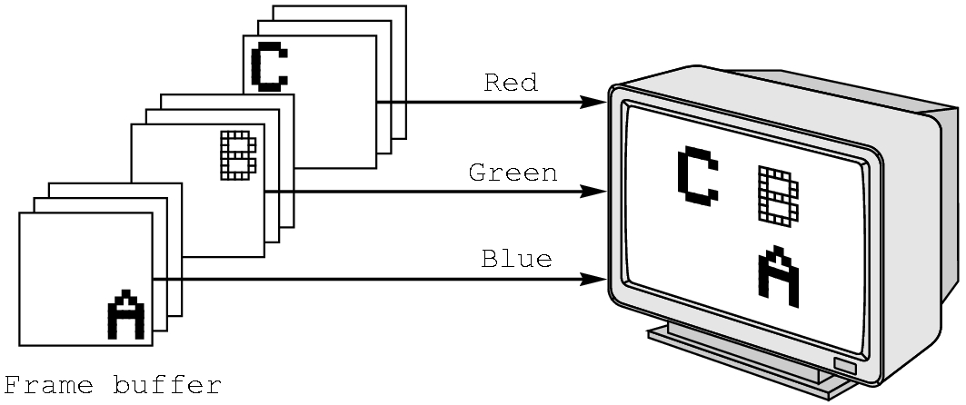
RGB color
Each color component is stored separately in the frame buffer
Usually 8 bits per component in buffer
Color values can range from 0.0 (none) to 1.0 (all) using floats or over the range from 0 to 255 using unsigned bytes
Angel and Shreiner: Interactive Computer Graphics 7E © Addison-Wesley 2015

Slide 58
Setting Colors
Colors are ultimately set in the fragment shader but can be determined in either shader or in the application
Application color: pass to vertex shader as a uniform variable or as a vertex attribute
Vertex shader color: pass to fragment shader as varying variable
Fragment color: can alter via shader code
Angel and Shreiner: Interactive Computer Graphics 7E © Addison-Wesley 2015

Slide 59
Example: Vertex Shader
attribute vec4 vColor;
varying vec4 fColor;
void main()
{
gl_Position = vPosition;
fColor = vColor;
}
Angel and Shreiner: Interactive Computer Graphics 7E © Addison-Wesley 2015

Slide 60
Corresponding Fragment Shader
precision mediump float;
varying vec3 fColor;
void main()
{
gl_FragColor = fColor;
}
Angel and Shreiner: Interactive Computer Graphics 7E © Addison-Wesley 2015

Slide 61
Sending Colors from Application
var cBuffer = gl.createBuffer();
gl.bindBuffer( gl.ARRAY_BUFFER, cBuffer );
gl.bufferData( gl.ARRAY_BUFFER, flatten(colors),
gl.STATIC_DRAW );
var vColor = gl.getAttribLocation( program, "vColor" );
gl.vertexAttribPointer( vColor, 3, gl.FLOAT, false, 0, 0 );
gl.enableVertexAttribArray( vColor );
Angel and Shreiner: Interactive Computer Graphics 7E © Addison-Wesley 2015

Slide 62
Sending a Uniform Variable
// in application
vec4 color = vec4(1.0, 0.0, 0.0, 1.0);
colorLoc = gl.getUniformLocation( program, ”color" );
gl.uniform4f( colorLoc, color);
// in fragment shader (similar in vertex shader)
uniform vec4 color;
void main()
{
gl_FragColor = color;
}
Angel and Shreiner: Interactive Computer Graphics 7E © Addison-Wesley 2015

